Slide 1
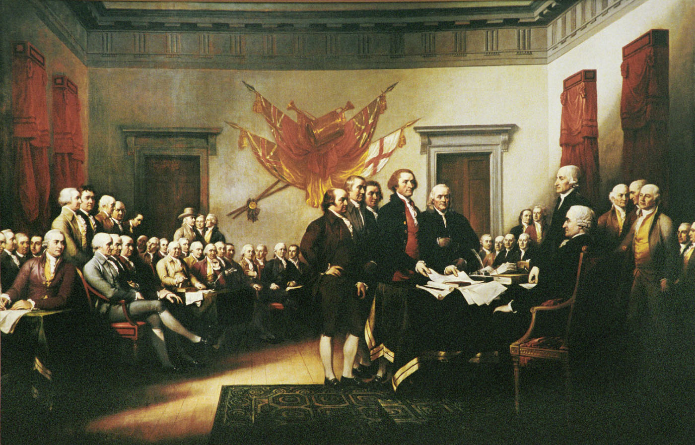
The Enlightenment Origins of the United States Government

Slide 2
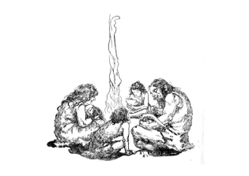
Origins of Government
Force Theory: superior strength
Evolutionary Theory: family structure
Divine Right Theory: royal birth
Social Contract Theory: voluntary

Slide 3
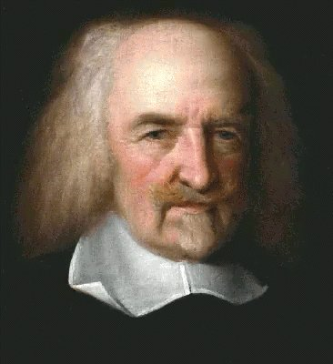
Thomas Hobbes
Wrote Leviathan
Argued that people were naturally cruel, greedy, and selfish.
Needed to be controlled or they would fight, rob, and oppress each other.
Believed that life in the “state of nature” without laws or control would be “solitary, poor, nasty, brutish, and short.”
Social contract: give up freedom for an organized society.

Slide 4
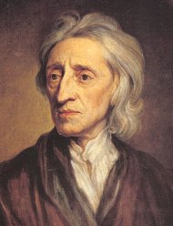
John Locke
Wrote Two Treatises of Government
Argued people formed governments to protect their natural rights.
Natural rights: Life, liberty, and property
Best government = limited power and accepted by all citizens
If government fails its obligations or violates its people’s natural rights, the people have the right to overthrow that government.

Slide 5
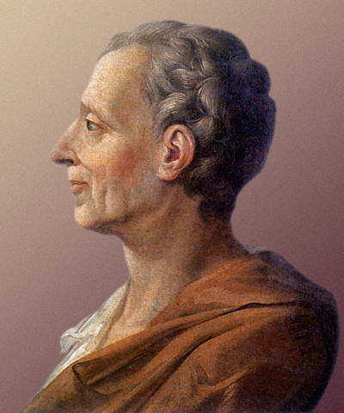
Baron de Montesquieu
Wrote Spirit of the Laws
Argued best way to protect liberty was to divide powers of government into three branches: executive, legislative, and judicial.
Branches should check the power of each other.
Separation of Powers: different powers/functions for each branch
Checks and Balances: each branch checks the power of the others giving balance to the system

Slide 6
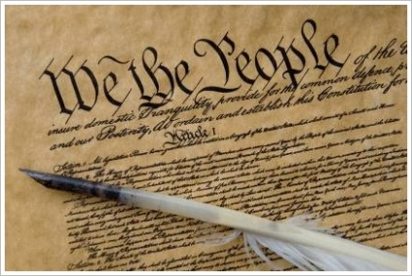
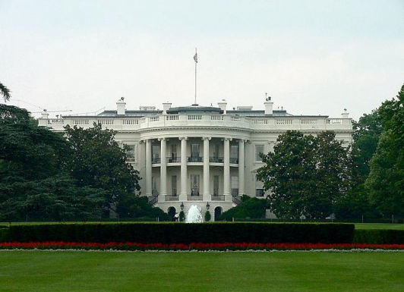
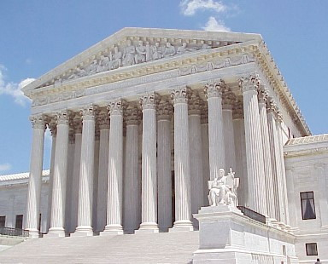
Checks & Balances
Nominate supreme court justices
Overrule veto. Impeach president.
Declare presidential acts unconstitutional
Veto laws.
Executive Branch
Approve presidential appointments. Impeach judges.
Declare laws unconstitutional
Judicial Branch
Legislative Branch

Slide 7
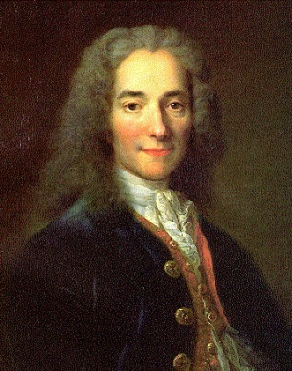
Voltaire
Real name: Francois-Marie Arouet
“My trade is to say what I think.”
Targeted corrupt officials, aristocrats, and the Catholic church.
Defended freedom of speech.
Against the slave trade and religious prejudice.
Imprisoned and exiled.

Slide 8
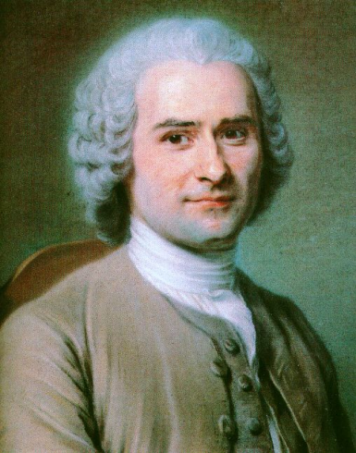
Jean-Jacques Rousseau
Wrote The Social Contract
Argued that natural innocence was corrupted by evils of society.
Government should have minimal controls and that only freely elected governments should impose these controls.
General Will: best conscience of the people

Slide 9
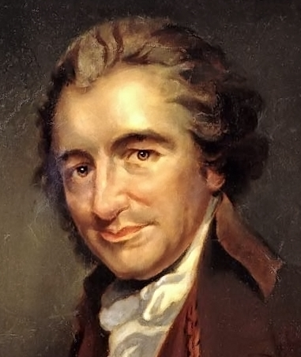
Thomas Paine
Wrote Common Sense
Argued that America needed to revolt from Britain.
Arguments against British Rule:
It was absurd for an island to rule a continent.
America was not a "British nation"; it was composed of influences and peoples from all of Europe.
Being a part of Britain would drag America into unnecessary European wars, and keep it from the international commerce at which America excelled.
The distance between the two nations made governing the colonies from England unwieldy. If some wrong were to be petitioned to Parliament, it would take a year before the colonies received a response.
The New World was discovered shortly before the Reformation. The Puritans believed that God wanted to give them a safe haven from the persecution of British rule.
Britain ruled the colonies for its own benefit, and did not consider the best interests of the colonists in governing them.

Slide 10
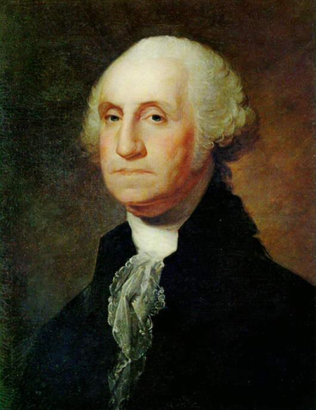
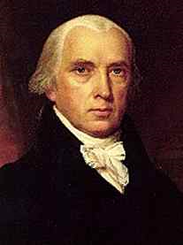
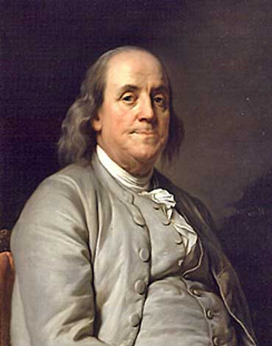
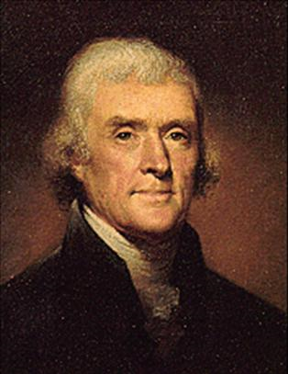
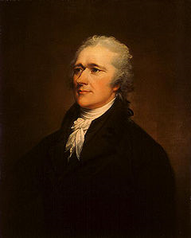
The Founders:
George Washington: Revolutionary general & 1st president
James Madison: main author of constitution, 4th president, federalist papers
Benjamin Franklin: revolutionary diplomat to France
Thomas Jefferson: 3rd president, primary author of Declaration of Independence
Alexander Hamilton: secretary of the treasury, federalist papers, economist

Slide 11
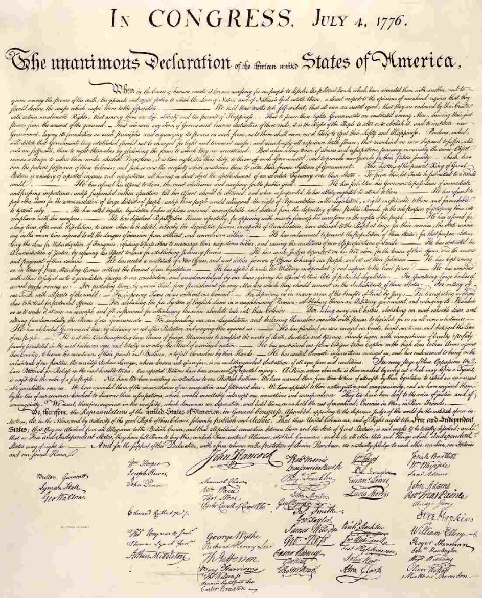
The Declaration of Independence
Adopted on July 4, 1776
Influenced by English Declaration of Rights & the work of John Locke
Outlined reasons for American Independence
“We hold these truths to be self-evident, that all men are created equal, that they are endowed by their Creator with certain unalienable Rights, that among these are Life, Liberty and the pursuit of Happiness.”

Slide 12
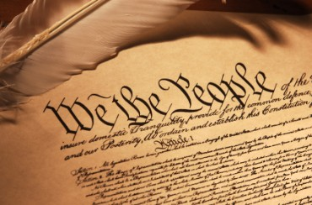
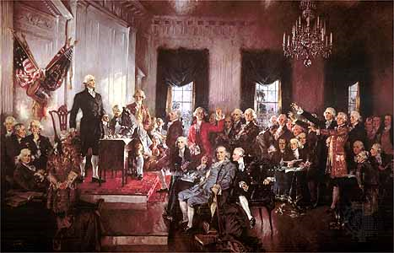
US Constitution
Supreme law of the USA
Framework for the organization of the government
Adopted Sep 17, 1787, by the Constitutional Convention in Philadelphia, Pennsylvania
Influences:
John Locke
Montesquieu
Magna Carta
English Bill of Rights

Slide 13
Purpose of Government:
“We the People of the United States, in Order to form a more perfect Union, establish Justice, insure domestic Tranquility, provide for the common defense, promote the general Welfare, and secure the Blessings of Liberty to ourselves and our Posterity, do ordain and establish this Constitution for the United States of America.”
Form a more perfect union: unite the colonies and improve the government
Establish justice: equal application of the law
Insure domestic tranquility: peace at home
Provide for the common defense: national defense
Promote the general welfare: government serves the needs of the people
Secure the blessings of liberty: freedom; “Eternal vigilance is the price of liberty.”

